Slide 1
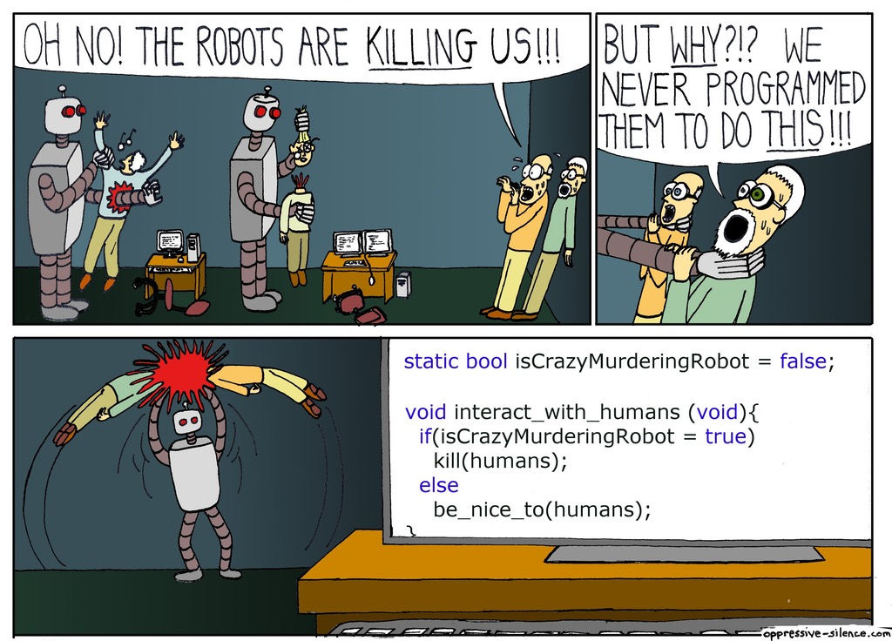
Introduction to Software Security
ING Tech Romania (November 2018)
Ionut Ambrosie, Software Security Engineer
Umami Team aka ING Tech Romania Security

Slide 2
Agenda for 18:00 – 20:00
Welcome and introduction
Threats to ING and not only
Walkthrough S-SDLC
Vulnerabilities explained
Hands on experience

Slide 3
What to expect from today’s lecture
Introduction to software security: engineering software so that it continues to function correctly or fail gracefully under malicious attack
Focus is on applications / software, less on infrastructure.
That this is not
Secure coding class (but we’ll touch on that)
Tooling (but we’ll touch on that)
Presenting compliance checklists telling you what to do (but we’ll give recommendations)
What this is
Building awareness and a shared conceptual understanding of software security
Sharing knowledge and information
Interrupt whenever you have questions!
Notes:
The purpose of this class is to build awareness through illustrating the characteristics and importance of SCR, SAST, DAST and PT, and to inform DevOps engineers on the activities that ING expects them to perform (and those activities they are not expected to perform but rather to delegate). This is a highly conceptual training which lays the foundation that is necessary to understand detailed issues that are encountered in a day-to-day setting while doing SCR, SAST, DAST and PT. As such, this training does not focus on secure coding concepts or tooling training (but one could be created if desired).

Slide 4
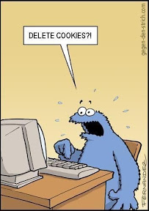
Agenda
Welcome and introduction
Threats to ING and not only
Walkthrough S-SDLC
Vulnerabilities explained
Hands on experience
Notes:
Hacking is a form of cybercrime or can be seen as such. This course does not focus on customer targeted malware such as banking trojans or ransomware, neither does it focus on other physical attacks such as skimming.

Slide 5





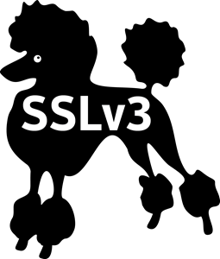
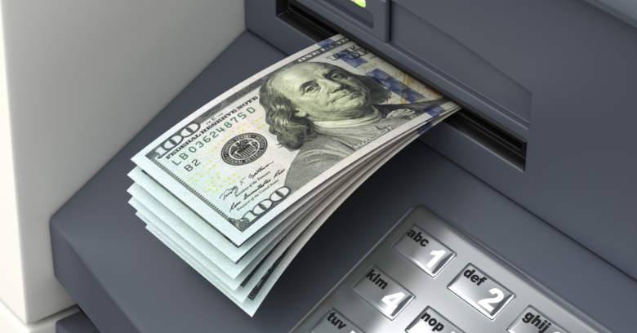
Recent security fails
Notes:
In 2011, the PSN hack notably attracted a lot of attention. However, insecurity is not simply a hype that ended somewhere after 2011. Recently, explicit media attention was devoted to a number of vulnerabilities such as Heartbleed, POODLE, Shellshock, and breaches such as those at Sony Pictures and Ashley Madison.
Estimated financial impact Sony Pictures breach: about $171 million
Ashley Madison is still involved in lawsuits, 2 years after the data breach occurred. The company behind Ashley Madison proposes to settle for 11.2 million USD in court (http://nos.nl/l/2183699)
DirtyCOW: 9 year old race condition that was found in the way Linux kernel’s memory subsystem “handled the copy on write (COW) breakage of private read-only memory mapping”. This can allow an unauthorized local user to exploit the vulnerability and increase their privileges by gaining write access to read-only memory.
Shellshock: Analysis of the source code history of Bash shows the vulnerabilities had existed since version 1.03 of Bash released in September 1989,^{[14][15]} introduced by Bash's original author Brian Fox.
WannaCry is interesting in the sense that it is the first publicly known malware that combines ransomware logic with exploiting a former 0day developed by the NSA.

Slide 6
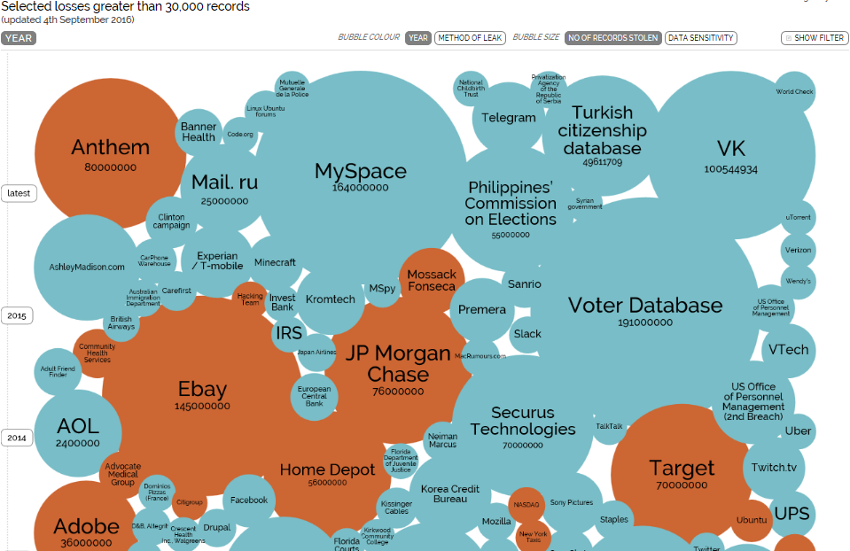
The World’s Biggest Data Breaches
Loss per record is hard to estimate: from $0,58 to $201 per record
informationisbeautiful.net/visualizations/worlds-biggest-data-breaches-hacks/, DBIR 2015
Notes:
Data breaches are occurring on a continuous basis, as illustrated by “The World’s Biggest Data Breaches”. We anticipate that media attention will intensify if a large financial player is compromised.
JP Morgan chase: names, addressses, phone numbers, emails of account holders (no customer financial data or SSN)
Ebay: through employee credentials database access of all user records and user credentials
Anthem: health insurer, names, dates of birth, SSN, address, phone numbers, email addresses and employment information
Target: POS terminals (swiped cards) malware accessing 40m creditcard info records
Home depot: malware on cash registeres also obtain creditcard information
DBIR 2015 estimation of the cost of a data records lost, USD 400 million for 700 million data records

Slide 7
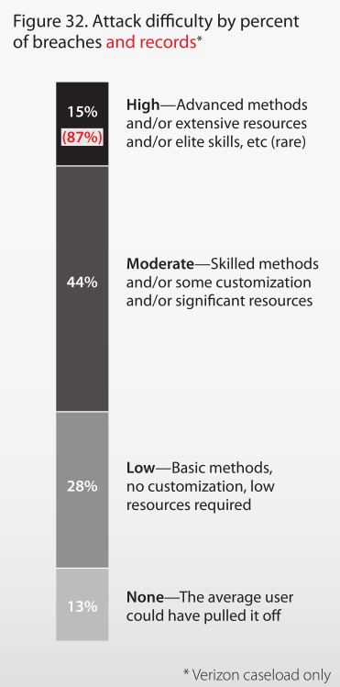
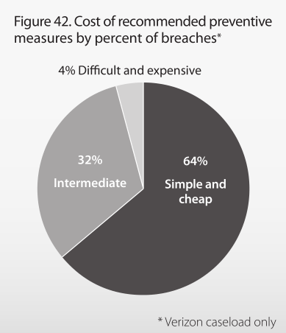
Am important percent of attacks are not sophisticated. Moreover, sometimes prevention is easy.
Source: Verizon 2010 World-wide survey on data breaches
Notes:
7
41% of all successful cyberattacks require no sophistication whatsoever. Web applications are a leading source of attack due to their ease of use, which essentially is a double edged sword. It is likely that a very large share of that 41% can be contributed to Web applications being targeted.
The solution to those breaches is likewise simple and cheap; there is still too much low hanging fruit around. A company’s risk exposure will drop considerably after addressing this low hanging fruit.

Slide 8
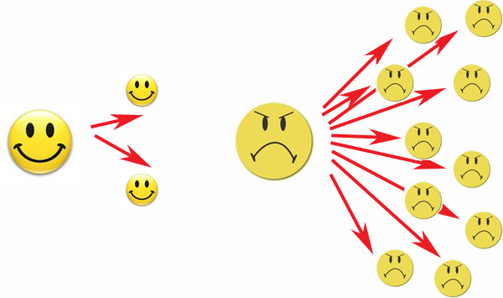
Possible consequences
Financial fraud
Regulatory scrutiny (ECB/MAS/…)
Brand or reputation damage
Identity theft
Lawsuits
Downtime
Malware propagation
Loss of customers
etc.
Maintaining customer trust is essential! We must develop secure software (and a lot of other stuff, but this training is focused on software security engineering).
But what exactly is secure software?
Notes:
Whatever the consequence, the success of our organization is largely dependent on customer trust. Developing and maintaining secure software is an important obligation in maintaining that trust.

Slide 9
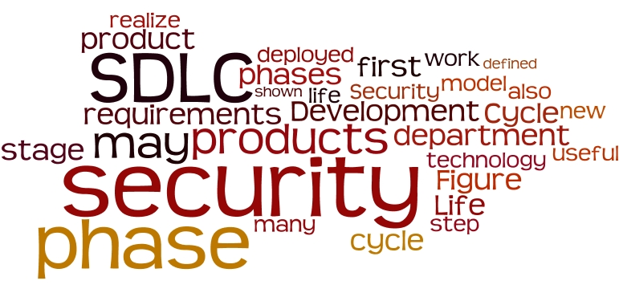
Agenda
Welcome and introduction
Threats to ING and not only
Walkthrough S-SDLC
Vulnerabilities explained
Hands on experience

Slide 10

What is secure software? Software security visualized
Functional defects
Security defects
Required behaviour
Real behaviour
Notes:
A more conceptual representation of what security really constitutes can be given through the use of a simple Venn diagram.
Software is complex in nature and will always behave (slightly) different than initially specified. When required behaviour exactly matches with behaviour in practice, everything is fine. When required behaviour does not occur, usually functionality is not implemented according to specifications and functional defects arise. Functional testing serves to discover those defects and prevent them from being shipped to production.
Software will invariably exhibit behaviour that was nor predescribed nor anticipated. While not all such behaviour is immediately problematic, these defects allow software to behave in ways it was not designed, which may lead to vulnerabilities being exploited by certain threats. This is the domain of security defects, which by definition cannot be found using traditional functional testing.
Two strategies must be applied: reduce the number security defects by specifying security requirements (such that they become required functionality and can be tested accordingly), but this doesn’t eliminate the need for security testing altogether. The domain of security defects is characterized by “unwanted behaviour”, which is inherently a series of negative use cases, which are hard to enumerate or predict.

Slide 11
We distinguish two types of security defects
Two types of security defects:
Bug: implementation-level software problem or defect in the code
Flaw: design-level or architectural defect in specifications or software that is more difficult to resolve once the software is partially or completely implemented
The distinction can be fuzzy: some defects are clearly bugs, some are clearly flaws, and some are debatable
As a rule of thumb, think: coding bug, design flaw
Bug
Flaw
Notes:
Security defects generally fall into two categories; bugs (implementation errors) and flaws (design or architectural errors). The difference can be subtle. The importance of this distinction is explained on the next slides.

Slide 12
Security defects: Bug or flaw?
Crash due to NullPointerException
bug
SQL injection
bug
Absence of required audit logging
flaw
char c[1024]; gets(c);
bug
Unsalted password hashes
flaw
Forgot to authenticate the user
flaw
Notes:
Participants of this course are asked to raise an orange or blue card to indicate whether they think this particular defect is a bug or a flaw.
Interesting detail: the 0-day vulnerability in Umbraco CMS which was demonstrated in the MijnGeld video is a flaw in the sense that it “forgot to authenticate the user” before uploading random (attacker-controlled) code.

Slide 13
S-SDLC in a nutshell
ING Tech RO
Example “Security Enhanced SDLCs”:
Microsoft Trustworthy Computing SDL
McGraw’s Seven Touchpoints of Secure Software
Oracle Software Security Assurance Process
OWASP Comprehensive, Lightweight Application Security Process (CLASP)
CMU SEI TSP-Secure
Appropriate and Effective Guidance in Information Security (AEGIS)
Rational Unified Process-Secure (RUPSec)
Secure Software Development Model (SSDM)
All have pros and cons, none will fit an organization perfectly
Notes:
McGraw developed the Seven Touchpoints for Software Security, which is one example of representing a SSDLC. Participants are asked to assign SCR, SAST, DAST and PT to one (or more) of the boxes.

Slide 14
The world of Secure Code Review
Terminology
Secure code review ≠ code scanning ≠ static code/program analysis
Automated techniques
SAST (Static Application Security Testing)
Advantages
Execution speed
Can cover all source code (in theory)
Manual techniques
Checklist style approach (OWASP Code Review Guide)
Specialism: needles in haystacks, but what does a needle look like?
Advantages
Find flaws! (and bugs of course)
Notes:
Secure code review is not the same as code scanning or static code analysis. Static program analysis is simply one of the ways to do SCR.
We use “static program analysis” or SAST to refer to automated (tool-driven) techniques to find security defects in code or binaries. A far more knowledge intensive methodology is to manually inspect code for security defects. This is also a secure code review but should only be attempted after having cleared the low hanging fruit using static analysis tooling.

Slide 15
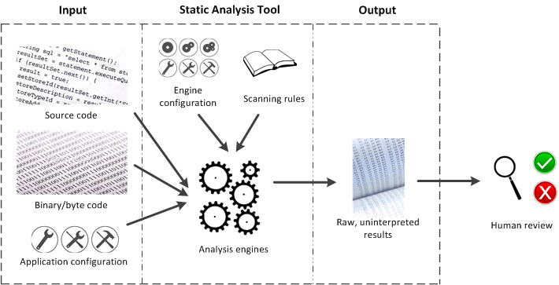
Operation of SAST tooling
Notes:
All static analysis tools operate in approximately the same fashion. Their engines process source or binary/byte code (or both), along with common forms of application configuration (think of configuration of common libraries and frameworks such as Log4j, Struts, etc.), further driven by a set of scanning rules that identify suspicious coding patterns and engine configuration (how deep should it search for those patterns?).
The result is always a mathematical approximation of reality (a raw, uninterpreted result), which always requires human inspection for a final judgement. Do not mistake tool results for conclusive facts as you will more often than not be chasing ghosts during remediation.

Slide 16



DAST vs. Penetration test (in a nutshell)
Manual testing
Manual testing
Scanning
Efficient
Injections and checks
in short time
Not that effective
Signature based
Don’t stop here
Effective
Human intelligence
Testing takes time
Dig deep enough
Notes:
[Courtesy of Dave van Stein, Security Consultant, ING]
The result of scanning is the starting point to continue manual testing. With scanning you get a first, but incomplete, impression. Don’t stop here. Tools inject many standard attack patterns, but are not able to interprete the application behaviour and logic.
Different attack patterns cannot be performed reliably in an automated way but need a manual approach such as the detection of logic flaws. Scanners miss vulnerabilties that do not have a standard signature: access control, logic flaws, leaking of sensitive information... and for those with standard signatures, automated attacks will mostly not bypass the validation mechanism, however a skilled attacker will be able to probe the mechanism, detect weakenesses and bypass it. Other attacks, such as SQL injection will not generate a standard signature because in many cases no errors or output data is generated and will not be detected by an automatic scanner. A path traversal attack may not result in the targeted file being represented in the application’s response.
Manual testing needs tools too as a support to strengthen and accelerate the testing process: mapping, enumerating, harvesting data, fuzzing...

Slide 17
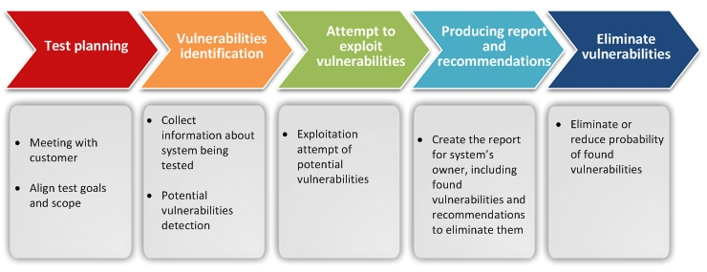
Penetration testing as a process
Notes:
Do not forget the fifth chevron! There is no point in executing a penetration test if the results are ignored.

Slide 18
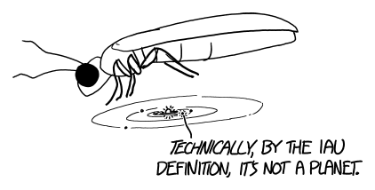
Agenda
Welcome and introduction
Threats to ING and not only
Walkthrough S-SDLC
Vulnerabilities explained
Hands on experience

Slide 19

Vulnerabilites OWASP Top 10 - 2017
About OWASP
Open Web Application Security Project founded in 2004 in US;
Community-driven project aimed at raising awareness on critical web application vulnerabilities;
More info at: https://www.owasp.org/index.php/Main_Page
OWASP Top 10
Most Critical Web Application Security Risks;
Broad consensus about the most critical security risks to web applications;
Shared security expertise from around the world to produce the list.
More info at: https://www.owasp.org/index.php/Top_10-2017_Top_10

Slide 20
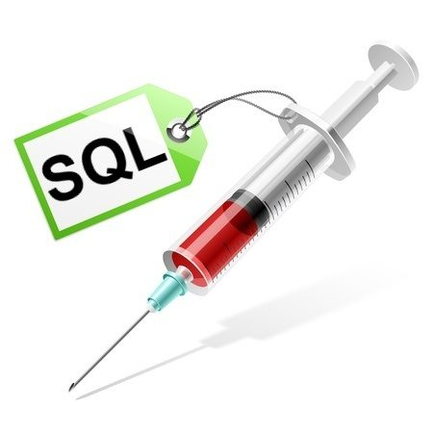
Vulnerabilities A1 – Injection
Injection occurs when untrusted data is sent to an interpreter as part of a command or query. The attacker’s hostile data can trick the interpreter into executing unintended commands or accessing data without proper authorization.
SQL;
LDAP;
NoSQL queries;
OS commands;
XML
Risk/ impact
Data loss;
Data corruption;
Disclosure to unauthorized parties;
Complete takeover

Slide 21
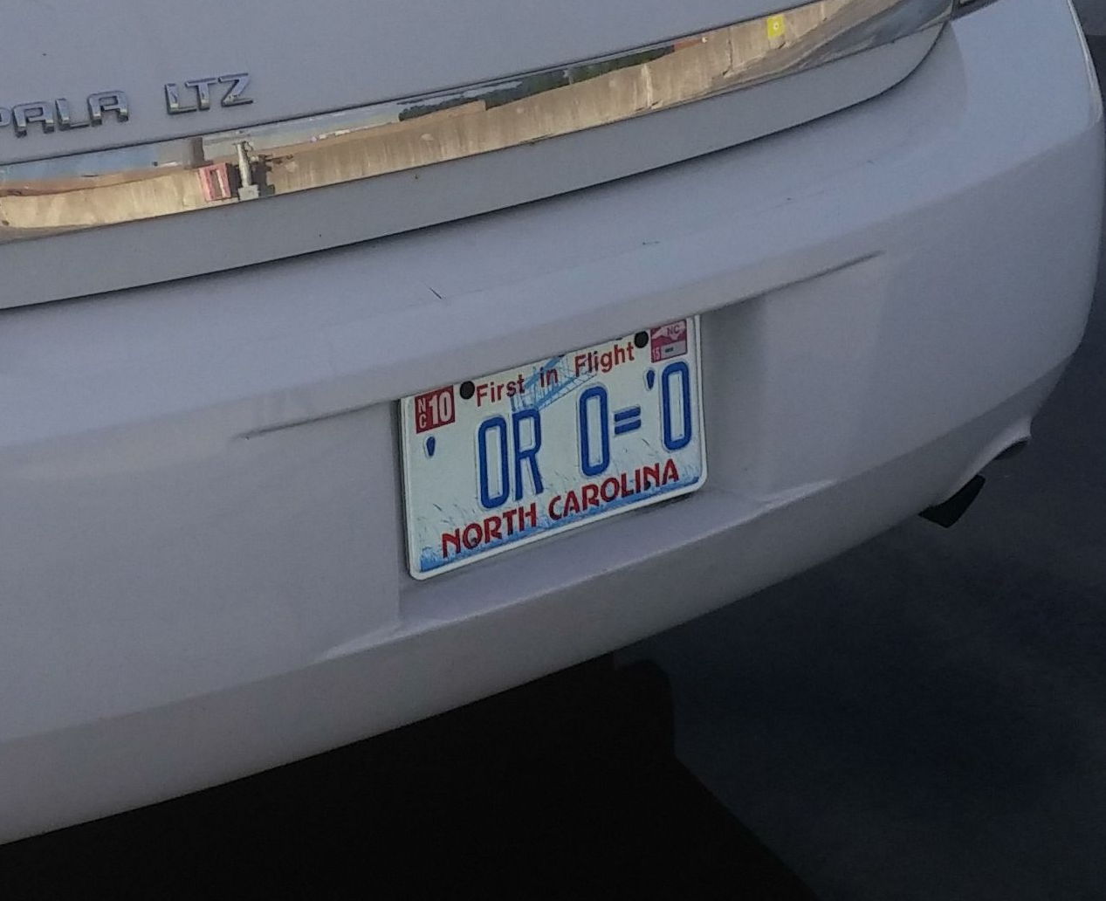
Vulnerabilities A1 – Injection - SQL
Vulnerable code
String Username = request.getParameter("USER"); // From HTTP request
String Password = request.getParameter("PASSWORD"); // From HTTP request
String sel = "SELECT User_id, Username FROM USERS WHERE Username = '" + Username + "' AND Password = '" + Password + "'";
Statement selectStatement = connection.createStatement();
ResultSet resultSet = selectStatement.executeQuery(sel);
Desired behavior
SELECT User_id, Username FROM USERS WHERE Username = 'USER' AND Password = 'PASSWORD'
Attack input
Input query in USER field:
sdfssd' or '1'= '1
Query becomes:
SELECT User_id, Username FROM USERS WHERE Username = 'sdfssd' or '1'= '1' AND Password='Password'
Result:
User_id with equivalent username enumeration of the DB;

Slide 22

Vulnerabilities A1 – Injection – SQL – Prevention & Defense In Depth
Prepared statements (with parameterized queries)
String query = "SELECT account_balance FROM user_data WHERE user_name = ?";
PreparedStatement pstmt = connection.prepareStatement(query);
pstmt.setString(1, custname);
ResultSet results = pstmt.executeQuery();
Stored procedures
Ex: use Java’s implementation of stored procedures in a CallableStatement
Whitelist input validation
Use predefined known good input in such as table_names, columns, alphanumeric chars, etc.
Avoid relying on blacklisting – can be bypassed;
Escape all user input
Platform and DB specific

Slide 23
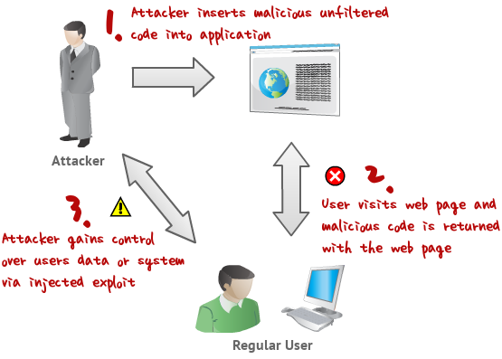
Vulnerabilities A7 - Cross-Site Scripting (XSS)
XSS flaws occur whenever an application takes untrusted data and sends it to a web browser without proper validation or escaping. XSS allows attackers to execute scripts in the victim’s browser which can hijack user sessions, deface web sites, or redirect the user to malicious sites.
Types of XSS:
Reflected
Stored
DOM based
Mutation XSS

Slide 24
Vulnerabilities A7 - Cross-Site Scripting (XSS) – Prevention & Defense In Depth
Deny all – don’t put untrusted data in un-allowed locations
scripts, comments, attribute names, tags, CSS;
Escaping – context aware
HTML, URL, attribute, JavaScript etc;
Use the HTTPOnly cookie attribute;
Content security policy
Only execute or render resources from whitelisted sources;
Use X-XSS protection response header
Use the built in XSS filter of some browsers;

Slide 25
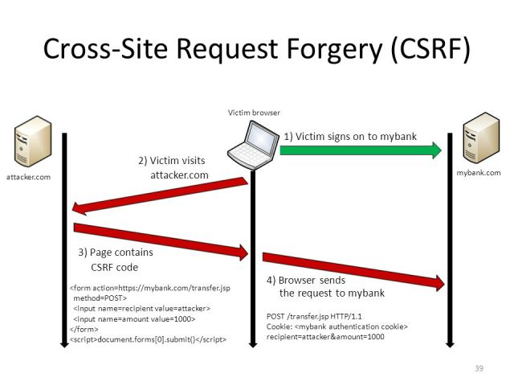
Vulnerabilities A8 (Top Ten 2003) - Cross-Site Request Forgery (CSRF)
CSRF is an attack that tricks a victim into submitting a malicious requests
It inherits the identity and privileges of the victim to perform undesired actions on the victim's behalf
The underlying cause is application functionality using predictable URL/form actions in a repeatable way
CSRF exploits the trust that a web site has for a user’s browser

Slide 26
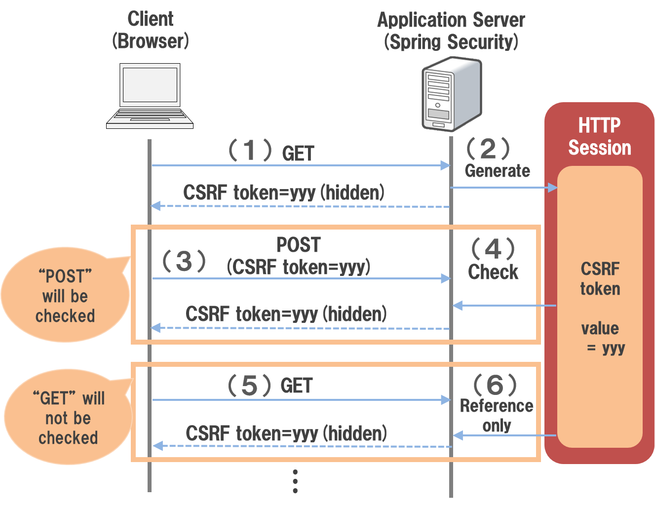
Vulnerabilities A8 (Top Ten 2003) - Cross-Site Request Forgery (CSRF) – Prevention & Defense in Depth
Synchronized (CSRF) tokens
Verify same origin with standard headers
Determine the origin of the request is coming from
Determine where the request is going to
Verify the two origins match
Use the SameSite cookie attribute

Slide 27
Vulnerabilities A5 - Broken Access Control – Insecure Direct Object Reference (IDOR)
Insecure Direct Object References occur when an application provides direct access to objects based on user-supplied input. As a result of this vulnerability attackers can bypass authorization and access resources in the system directly, for example database records or files.
Sample request:
http://foo.bar/showImage?img=img00011
By providing the name of a different file, an attacker might be able to retrieve objects which he does not own.
Prevention & Defense In Depth
Access control checks– design and implementation phase;
Indirect reference mapping – design and implementation phase;
User input validation
Per session/ user indirection

Slide 28

Agenda
Welcome and introduction
Threats to ING and not only
Walkthrough S-SDLC
Vulnerabilities explained
Hands on experience

Slide 29
SCW Session
Check you email and make sure you can access SCW
Play around on the platform for 10 minutes, make sure you understand how it works
Join the assessment. You’ve got 20 minutes to finish.

Slide 30

</session>

